Slide 1
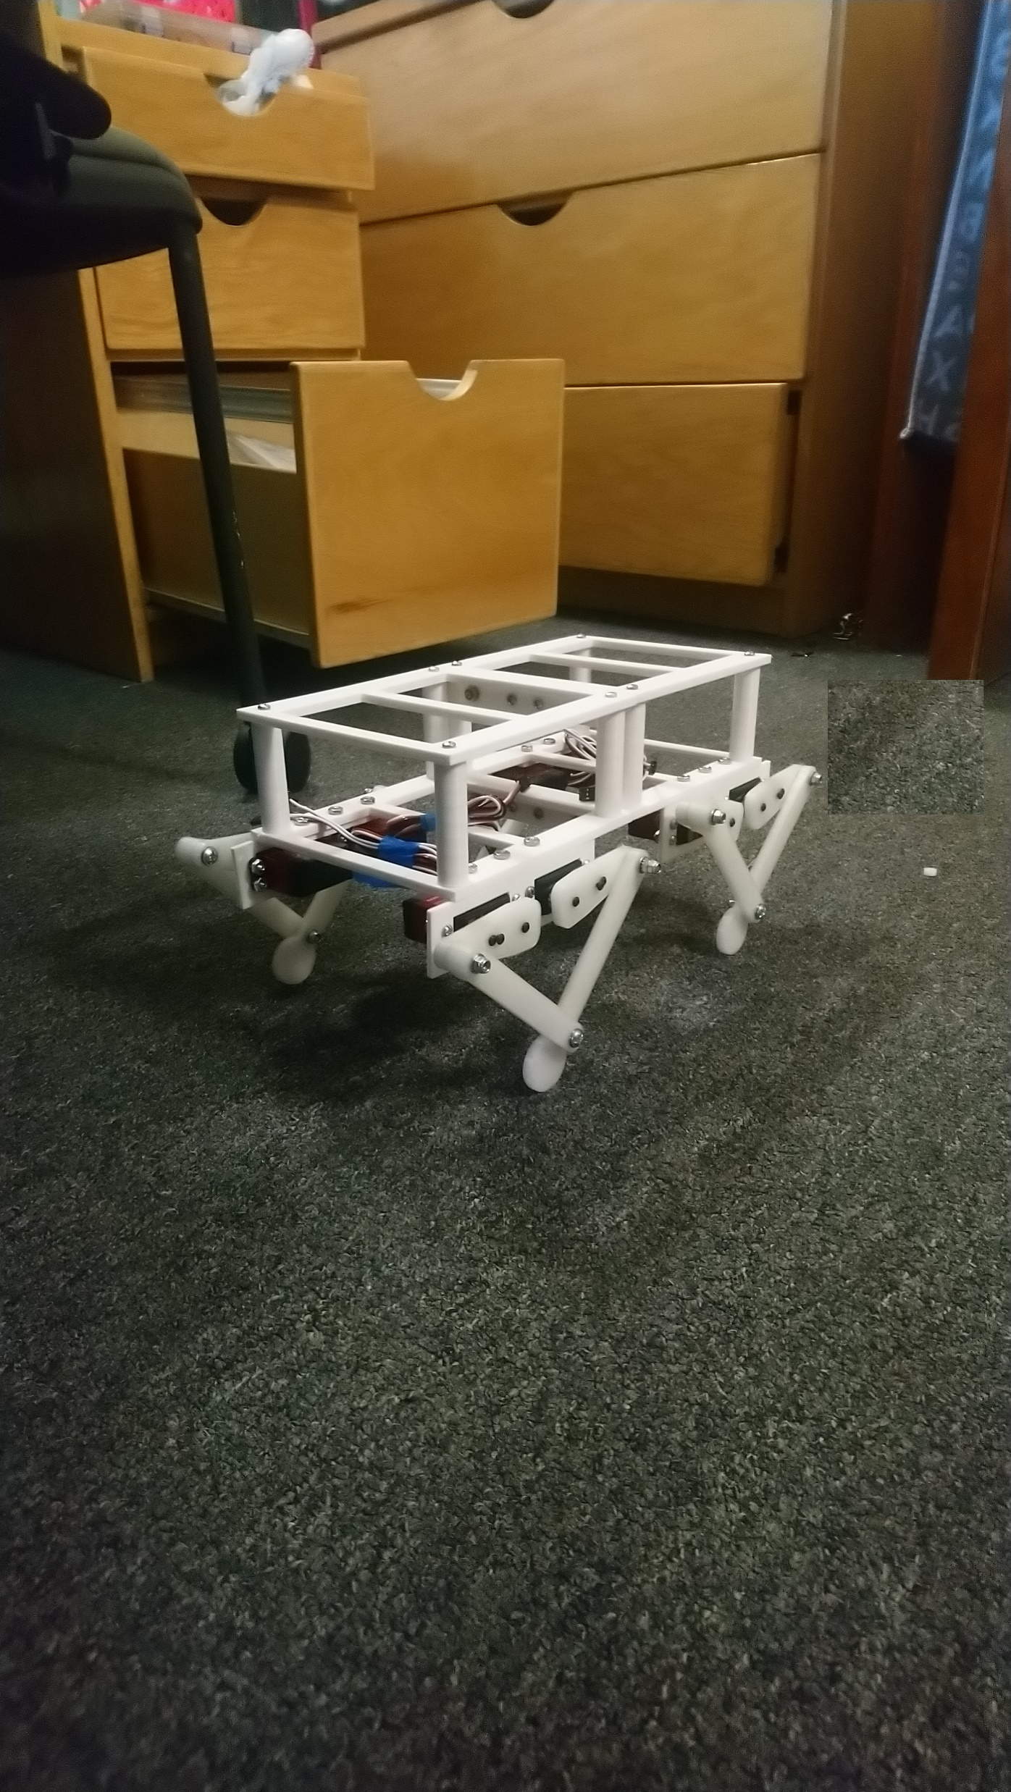
Quadruped Robot
Hung Cao, Computer Science Major
Dr. Sergei bEZROUKOV, Math and Computer Science Department.

Slide 2
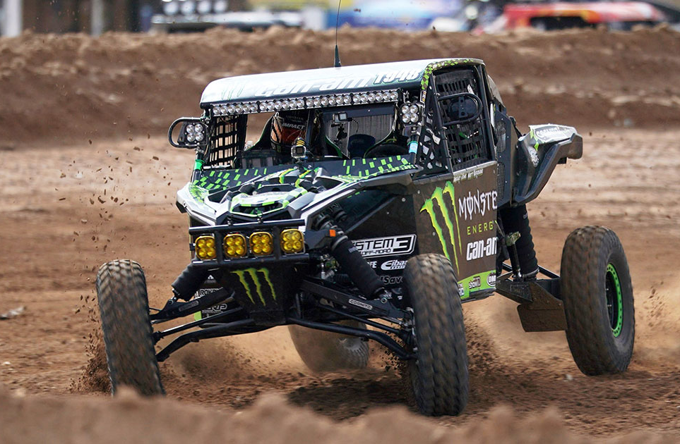
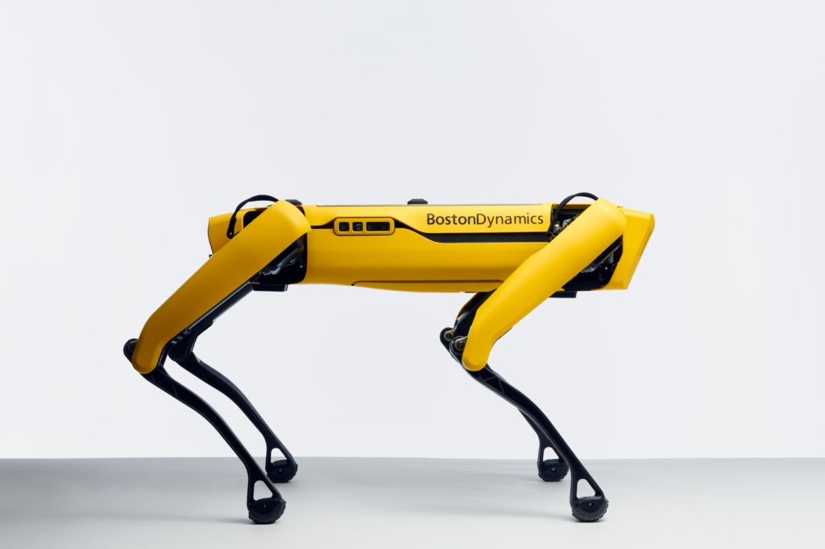
Background
In recent years, quadruped robot has been researched and developed to overcome weaknesses of off-road systems such as wheel and track systems.
Boston Dynamics is one of leading companies in the development of this robot.
Today, quadruped robot can operate on a variety of terrains such as, slippery, gravel, mud…

Slide 3
Research Objective
Applying programming knowledge on microcontrollers from CS224 class.
Combine trigonometry, mechanical and programming knowledge to solve a practical problem.
Evaluate the final design of the robot.

Slide 4
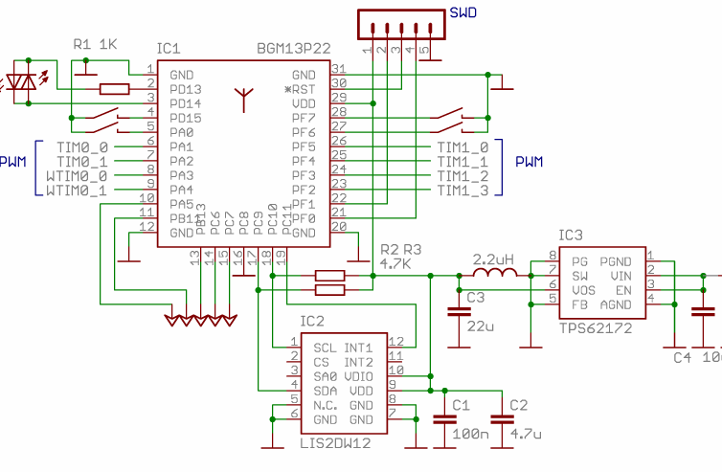
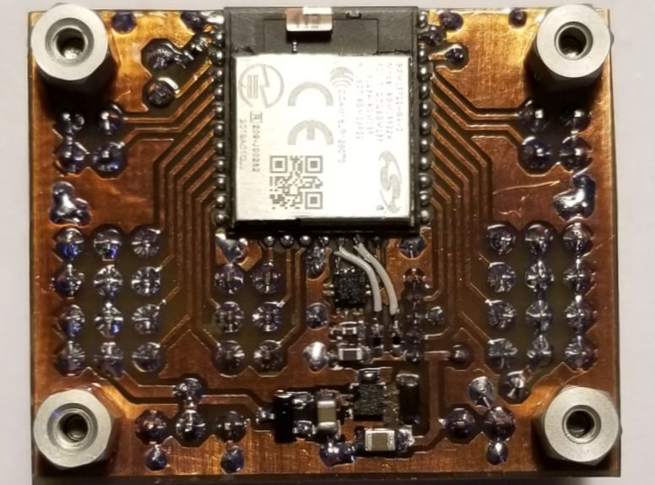
Process.
Research on the walking activities of 4-legged animals.
Learn solutions to simulate the walking activities of a 4-legged animal on a robot.
Select electrical components for the robot (battery, servo motors, microcontroller, etc.)
Simulation of robot parts using 3d Modeling software Called Adobe Inventor.
Print and assembly chassis and legs ON 3d printer.
Develop a program for microcontroller to control servos.
Programming one leg of Robot.
Programming and Synchronizing All legs of robot.
Adjust the operation of the robot for A smoother Movement.
Develop software to control robot by phone via Bluetooth.

Slide 5
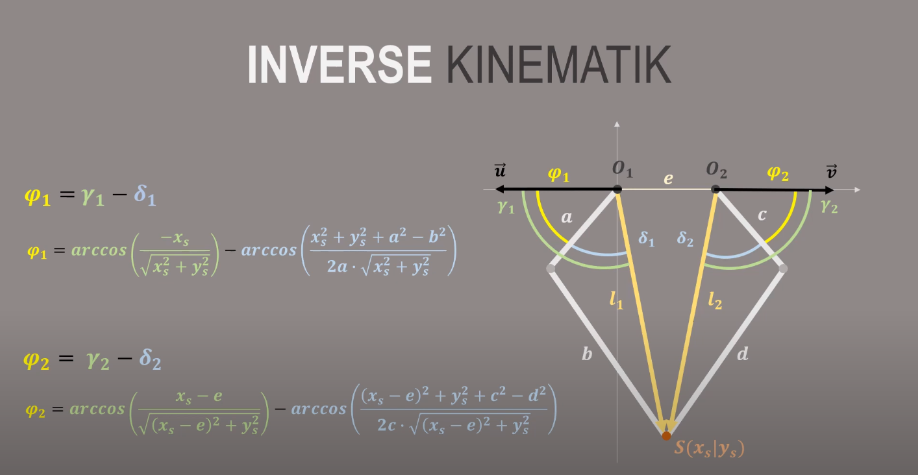
Method.
Programming knowledge about microcontroller In Cs224 class.
5 Bars parallel system.
Synchronous operation of Two Servos per leg.
Trigonometric and Inverse Kinematics.

Slide 6
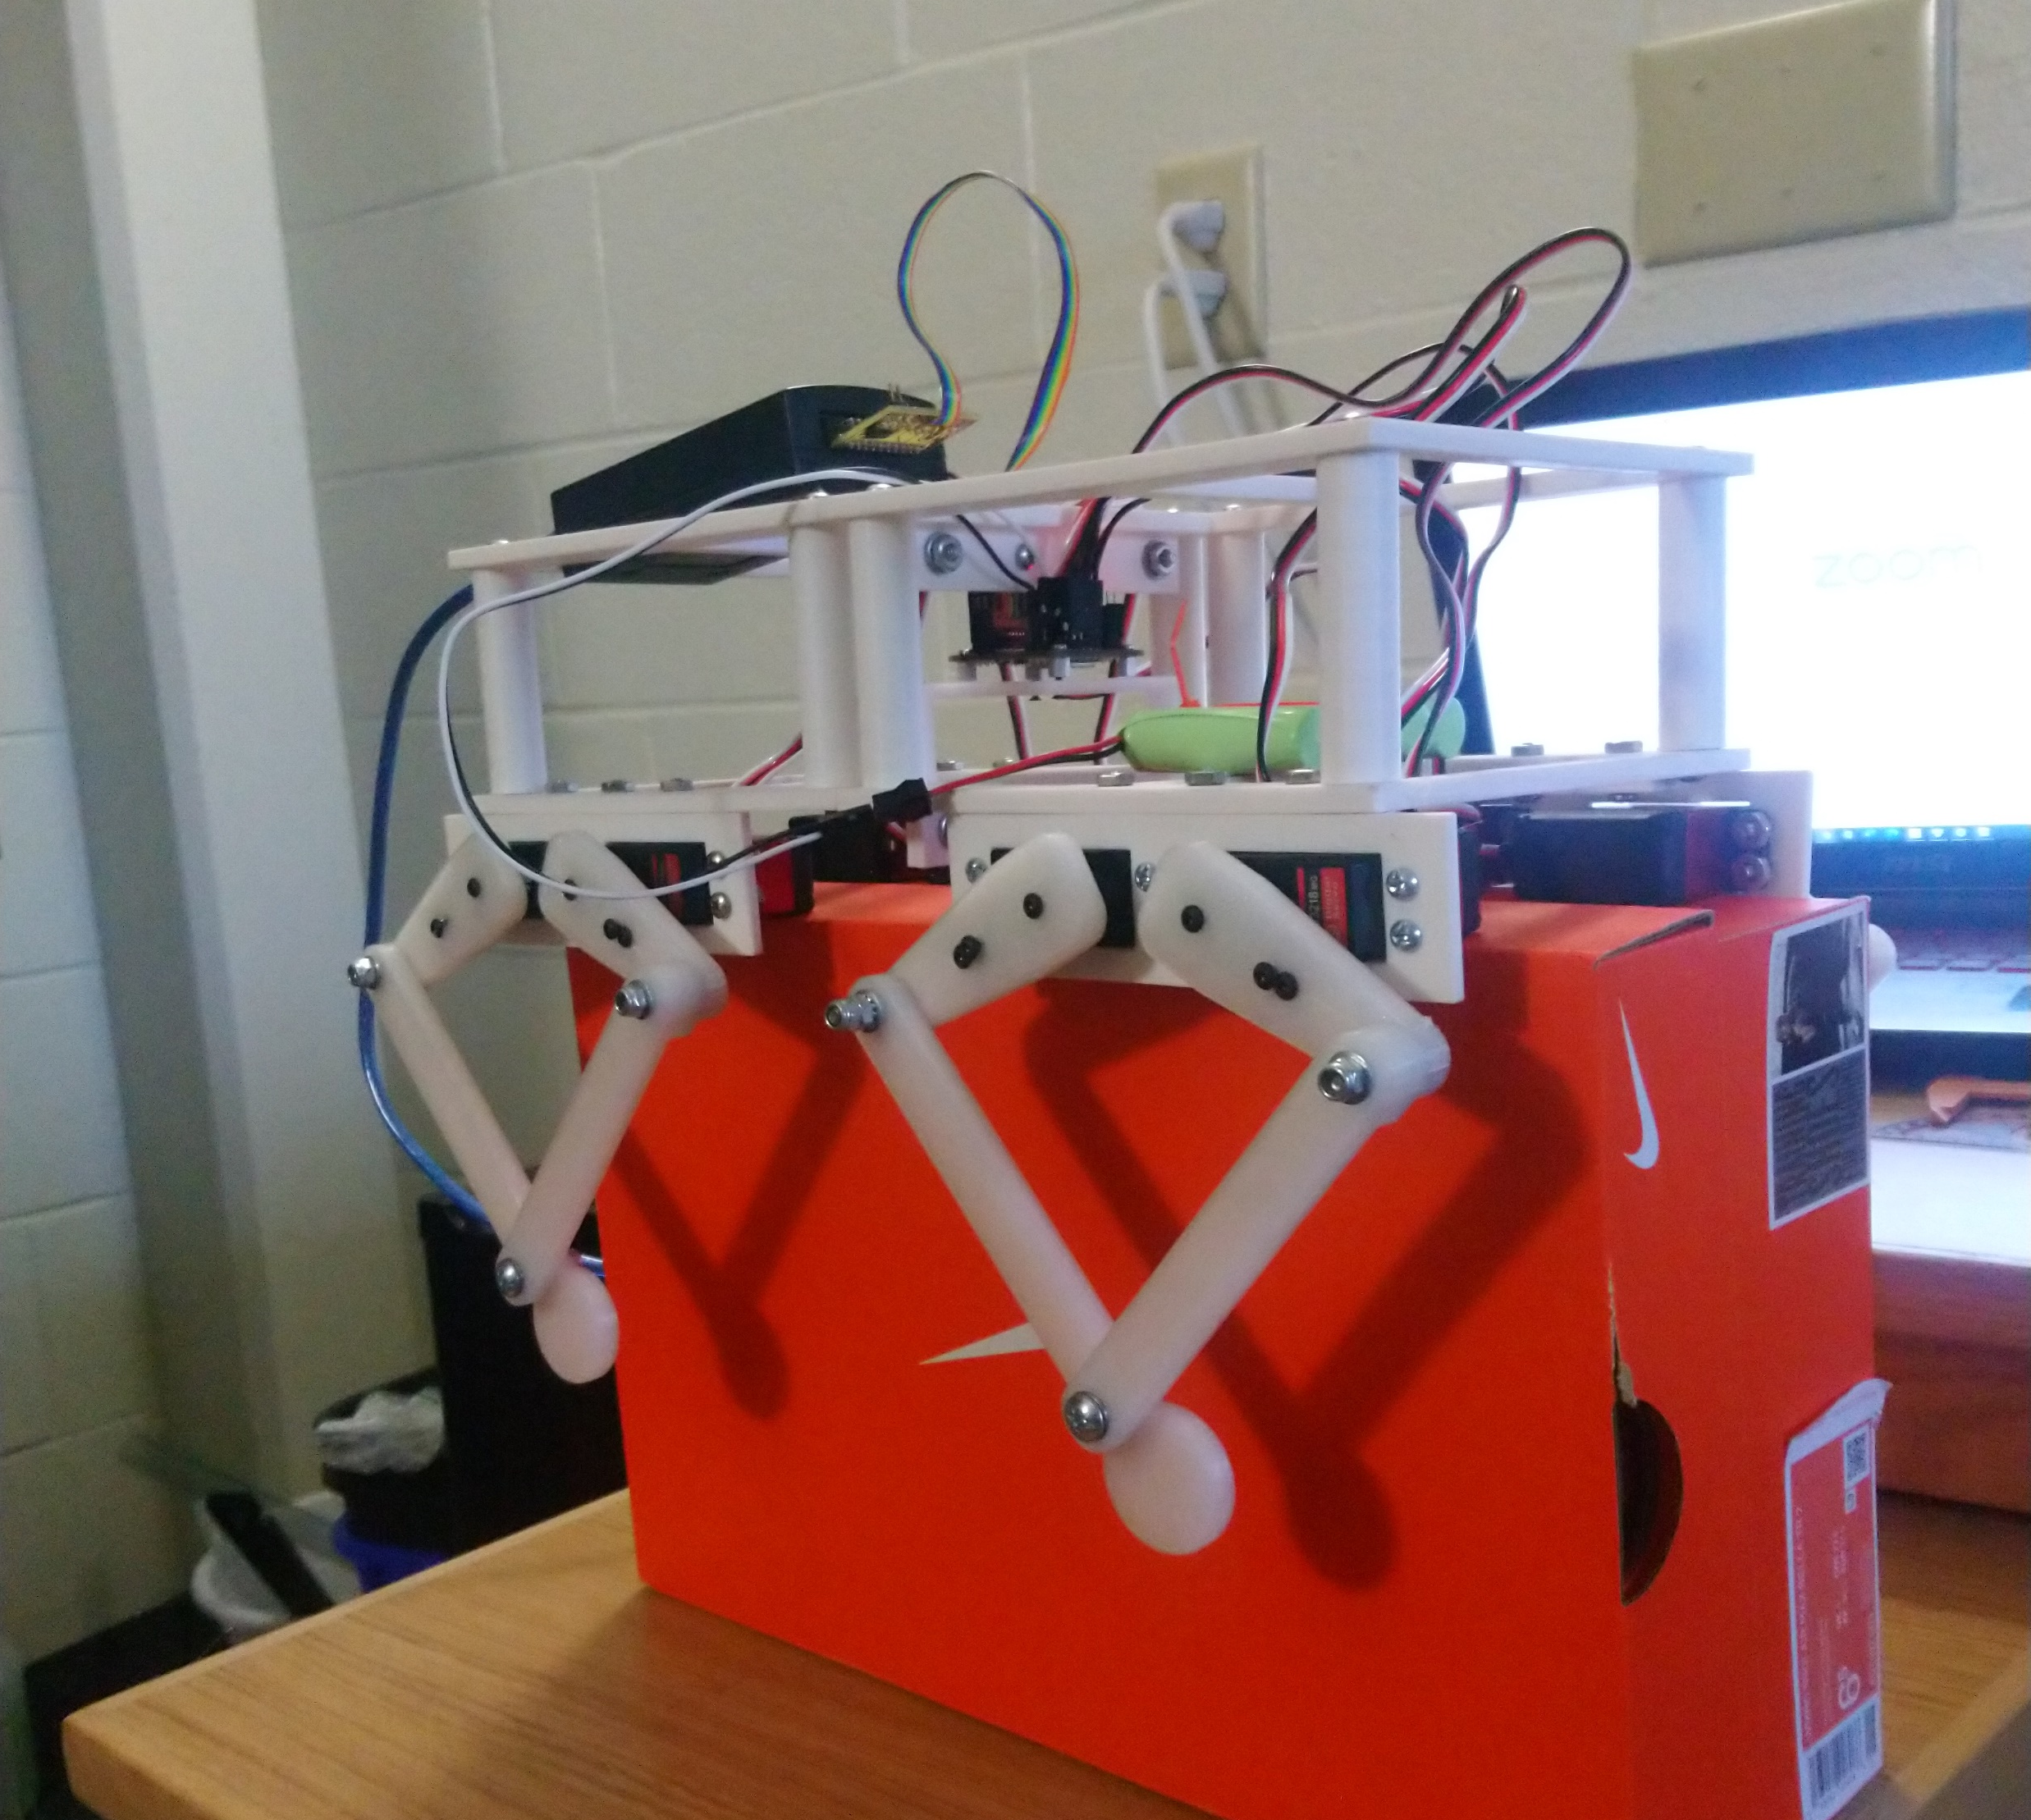
Result
The robot is assembled on a printed chassis and has 4 legs .
Robot can walk, turn left, turn right, turn around, walk backwards.
One can control the robot via Bluetooth with commands of the software EFR CONNECT .

Slide 7
Robot Operation.

Slide 8
Outcomes
The results have matched my expectations
Some problems REMAIN:
Battery Power is not enough For an autonomous operation. Now, the Robot is powered from a wall adapter.
The servo motors are not fast enough for the robot to perform more Complicated movements like Jumping and flipping.
I Will Continue this project in the capstone class and develop balancing of the robot with the gyroscope and Accelerometer sensor.

Slide 9
Conclusion.
I applied the knowledge gained in CS224 class to this project.
Application of programming, trigonometry, and mechanics to solve a practical problem.
Learned a lot on microcontroller programming, and the way to do research.
Good starting point for my future work.
My research today will contribute to the development of 4-legged robots technology.
These robots in the future will work on a variety of terrains and perform many different tasks.

Slide 10
References
Educational Five-Bar Parallel Robot .https://hackaday.io/project/173325-educational-five-bar-parallel-robot
Sinus I | #1: Inverse Kinematik (eng. subtitles).(2020). https://www.youtube.com/watch?v=NeHCVNUcZrw
How to Control Multiple Servo Motors Using Arduino – Automatic Addison. Automaticaddison.com. (2020). https://automaticaddison.com/how-to-control-multiple-servo-motors-using-arduino/

Slide 11
Questions?

